Slide 1

Introduction and Team Overview
Michigan Hackers Machine Learning Team
Notes:
Machine learning (ML) is currently one of the hottest areas in computer science. Many underclassmen in computer science have heard of ML and are intrigued by it, but must wait until after EECS 281 to enroll in a formal ML class. Self-teaching ML can seem like a daunting task, but by creating the Machine Learning Team at Michigan Hackers, it would provide the guidance and resources necessary for students to explore many aspects of ML. The team would also be useful for more experienced students in ML to collaborate on independent projects.

Slide 2

Meet Vijay
Junior in CSE
Minoring in Math
From Palo Alto, CA

Slide 3

Meet Raj
Junior in CSE
Minoring in Math and Physics
Work on MIRT.jl framework
From Saint Joe, MI

Slide 4

Team Goals
To create a peer-to-peer community of undergraduates interested in machine learning
To provide resources and guidance to aid in learning Python, data science, and machine learning
To collaborate on projects with team members

Slide 5
Team Structure
The team will revolve around creating a solid foundation to learn ML through books, online courses, and projects.
Weekly presentations
First month: basics of ML, basics of Python and libraries, setting up Python environment, basic mathematical concepts
Following months: discuss topics in ML (computer vision, NLP, neural networks) and the algorithms and libraries for each. Projects will accompany these lectures
Members who already have prior experience in ML can collaborate with other experienced members on independent projects and Kaggle competitions

Slide 6
Semester Milestones
September 2020
November 2020
October 2020
December 2020
Introduction
Project 2: Sentiment Analyzer
Bootcamp |  |  |  | Projects
Project 1: Flower Image Classifier
Project 3: Stock Price Predictor

Slide 7


Machine Learning
A subset of artificial intelligence where the computer independently learns from data and performs tasks without any explicit instructions.
Supervised Learning Labeled data: classification, regression
Unsupervised Learning Unlabeled data: clustering, decision trees
Reinforcement Learning Trial and Error: navigation, learning tasks

Slide 8
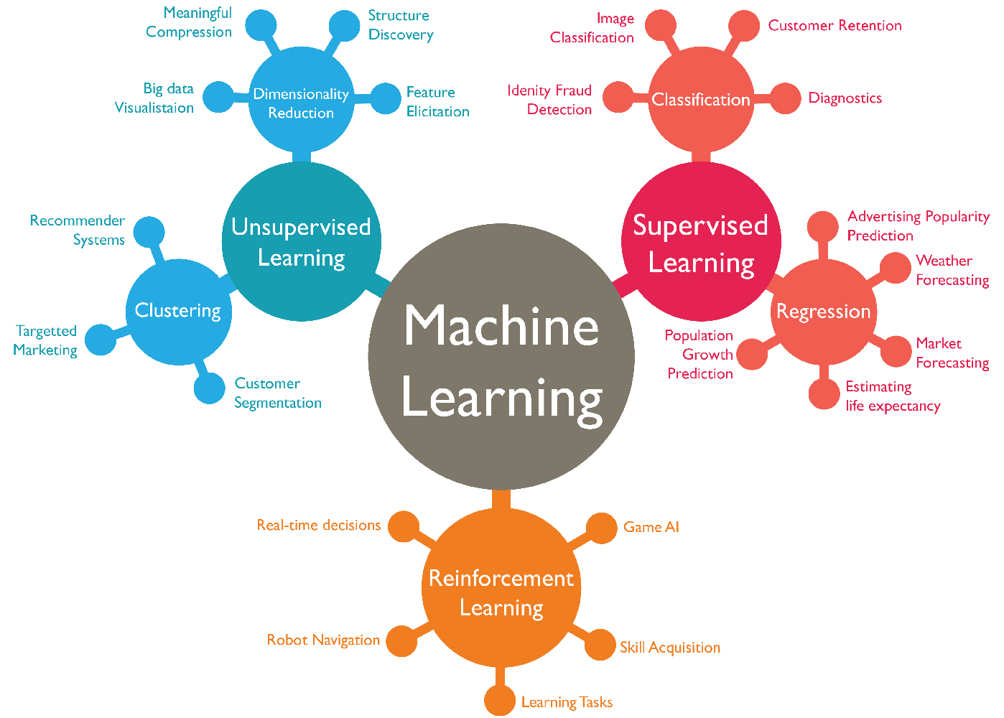

Slide 9
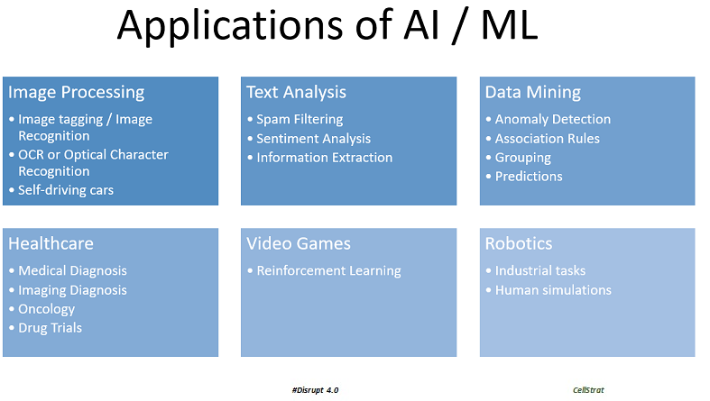

Slide 10
Recommended Books
Python Crash Course
Beginner
Data Science from Scratch
Intermediate
Hands-On Machine Learning
Advanced
Click on each tab to access the book

Slide 11
Recommended E-Courses
Kaggle Courses
Several mini-tutorials that introduce everything from basic Python to deep learning to game AI.
Andrew Ng’s ML Course
A free online course on Coursera taught by Stanford Professor Ng. Known to be the most popular ML e-course.
Google ML Crash Course
For more experienced developers. Introduces Tensorflow 2.0 with several online projects.
Click on each tab to access each online course

Slide 12
For Next Week...
Download the Onboarding Document and go through the steps to join MHML
Look over the recommended books and e-courses and fill out this form to let us know what your preferences
Schedule a meeting with the team leads to have a casual meet-n-greet
Learn Python from courses 1-3 of this Coursera specialization, and/or set up Jupyter and Anaconda on your computer
If you have more experience with ML and want to work at your own pace, write up a proposal on what you want to accomplish and email it to the team leads.

Slide 13
Thank You!
Michigan Hackers Machine Learning Team
Contact Info:
Rajas Gupta | rajasg@umich.edu
Vijay Shamra | vsharm@umich.edu
Provide Feedback

